Slide 1
Day 9
Design Patterns, Collection Framework – 2nd session, Functional Programmming, Log4J

Slide 2
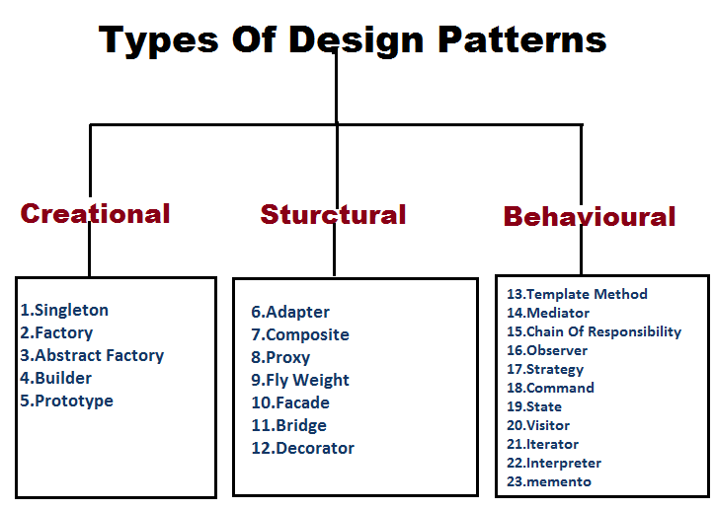
Design Patterns

Slide 3
Design Patterns
Design patterns are typical solutions to common problems in software design. Each pattern is like a blueprint that you can customize to solve a particular design problem in your code.
Design patterns differ by their complexity, level of detail and scale of applicability. In addition, they can be categorized by their intent and divided into three groups.

Slide 4
What’s the pattern consist of?
Intent of the pattern briefly describes both the problem and the solution.
Motivation further explains the problem and the solution the pattern makes possible.
Structure of classes shows each part of the pattern and how they are related.
Code example in one of the popular programming languages makes it easier to grasp the idea behind the pattern.

Slide 5
Design Patterns
History of patterns
When a solution gets repeated over and over in various projects, someone eventually puts a name to it and describes the solution in detail. That’s basically how a pattern gets discovered.

Slide 6
DP
The idea was picked up by four authors: Erich Gamma, John Vlissides, Ralph Johnson, and Richard Helm. In 1994, they published Design Patterns: Elements of Reusable Object-Oriented Software, in which they applied the concept of design patterns to programming.

Slide 7
Design Patterns
The book featured 23 patterns solving various problems of object-oriented design and became a best-seller very quickly.

Slide 8
Design Patterns
Creational patterns provide object creation mechanisms that increase flexibility and reuse of existing code.
Structural patterns explain how to assemble objects and classes into larger structures, while keeping these structures flexible and efficient.
Behavioral patterns take care of effective communication and the assignment of responsibilities between objects.

Slide 9
Design Patterns
https://refactoring.guru/design-patterns/catalo
Singleton is a creational design pattern that lets you ensure that a class has only one instance, while providing a global access point to this instance. g

Slide 10
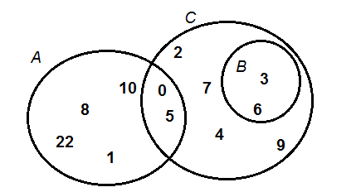
Collections – 2nd session - Set

Slide 11
Collections – 2nd session
Set
The following characteristics differentiate a Set collection from others in the Java Collections framework:
Duplicate elements are not allowed.
Elements are not stored in order. That means you cannot expect elements sorted in any order when iterating over elements of a Set.

Slide 12
Collections – 2nd session
Why and When Use Sets?
Based on the characteristics, consider using a Set collection when:
You want to store elements distinctly without duplication, or unique elements.
You don’t care about the order of elements.

Slide 13
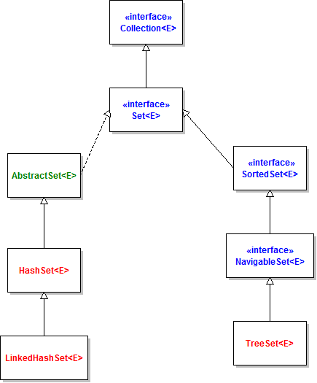
Set

Slide 14
Collections – 2nd session
HashSet: is the best-performing implementation and is a widely-used Set implementation. It represents the core characteristics of sets: no duplication and unordered.
LinkedHashSet: This implementation orders its elements based on insertion order. So consider using a LinkedHashSet when you want to store unique elements in order.
TreeSet: This implementation orders its elements based on their values, either by their natural ordering/values, or by a Comparator provided at creation time.

Slide 15
Collections
Creating a new Set
Trick to remove duplicate in other non-set collection
Subset opn:
containsAll
addAll
retainAll
removeAll

Slide 16
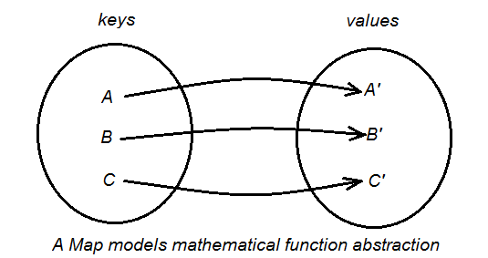
Map
A Map is an object that maps keys to values, or is a collection of attribute-value pairs. It models the function abstraction in mathematics. The following picture illustrates a map:

Slide 17
Maps
A Map cannot contain duplicate keys and each key can map to at most one value. Some implementations allow null key and null value (HashMap and LinkedHashMap) but some does not (TreeMap).
Why and When Use Maps:
Maps are perfectly for key-value association mapping such as dictionaries. Use Maps when you want to retrieve and update elements by keys, or perform lookups by keys. Some examples:
A map of error codes and their descriptions.
A map of zip codes and cities.
A map of managers and employees. Each manager (key) is associated with a list of employees (value) he manages.
A map of classes and students. Each class (key) is associated with a list of students (value).

Slide 18
Map
HashMap: this implementation uses a hash table as the underlying data structure. It implements all of the Map operations and allows null values and one null key. This class is roughly equivalent to Hashtable - a legacy data structure before Java Collections Framework, but it is not synchronized and permits nulls. HashMap does not guarantee the order of its key-value elements. Therefore, consider to use a HashMap when order does not matter and nulls are acceptable.
LinkedHashMap: this implementation uses a hash table and a linked list as the underlying data structures, thus the order of a LinkedHashMap is predictable, with insertion-order as the default order. This implementation also allows nulls like HashMap. So consider using a LinkedHashMap when you want a Map with its key-value pairs are sorted by their insertion order.
TreeMap: this implementation uses a red-black tree as the underlying data structure. A TreeMap is sorted according to the natural ordering of its keys, or by a Comparator provided at creation time. This implementation does not allow nulls. So consider using a TreeMap when you want a Map sorts its key-value pairs by the natural order of the keys (e.g. alphabetic order or numeric order), or by a custom order you specify.

Slide 19
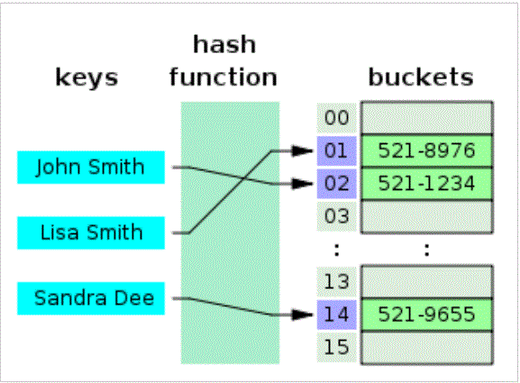
Hash table

Slide 20
Hashcode
According to Joshua Bloch's Effective Java (a book that can't be recommended enough, and which I bought thanks to continual mentions on stackoverflow):
The value 31 was chosen because it is an odd prime. If it were even and the multiplication overflowed, information would be lost, as multiplication by 2 is equivalent to shifting. The advantage of using a prime is less clear, but it is traditional. A nice property of 31 is that the multiplication can be replaced by a shift and a subtraction for better performance: 31 * i == (i << 5) - i. Modern VMs do this sort of optimization automatically.

Slide 21
Javadocs suggestion
it is generally necessary to override the hashCode method whenever this method is overridden, so as to maintain the general contract for the hashCode method, which states that equal objects must have equal hash codes.
https://docs.oracle.com/javase/7/docs/api/java/lang/Object.html#toString()
https://docs.oracle.com/javase/7/docs/api/java/lang/Character.html#toString()
https://docs.oracle.com/javase/7/docs/api/java/util/Calendar.html

Slide 22
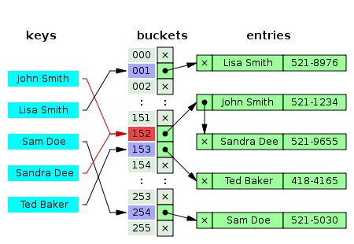
Hash Collision
Notes:
https://www.baeldung.com/java-hashcode

Slide 23
Hash code
t's clear that producing efficient hashCode() implementations often requires a mixture of a few mathematical concepts (i.e. prime and arbitrary numbers), logical and basic mathematical operations.
Regardless, we can implement hashCode() effectively without resorting to these techniques at all. We just need to make sure the hashing algorithm produces different hash codes for unequal objects and that it's consistent with the implementation of equals().
https://www.baeldung.com/java-hashcode

Slide 24
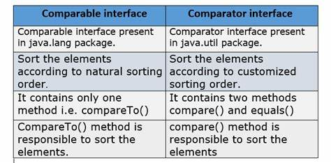
Collections.sort

Slide 25
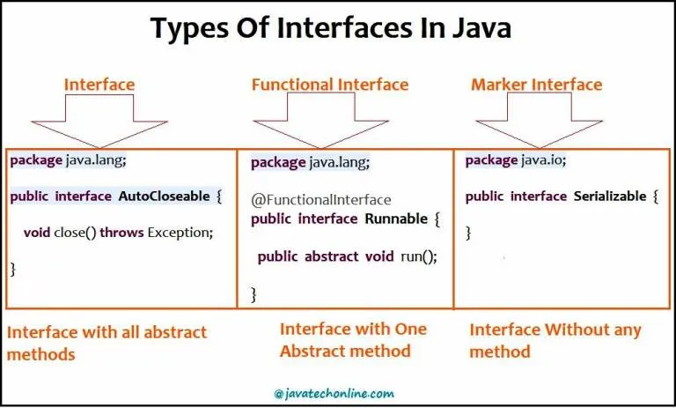
Functional Programming

Slide 26
FP
1) Normal Interface(1or < abstract methods) 2) Marker Interface(no methods , just to execute or apply some logic) 3) Functional Interface(1 – Abstract, default or static )

Slide 27
Existing Interfaces with SAM
Examples of Functional Interfaces:
Runnable : contains only run() method Comparable : contains only compareTo() method ActionListener : contains only actionPerformed() Callable : contains only call() method ItemListener : contains only itemStateChanged() method

Slide 28
Lambda
The lambda calculus is old; old enough that it predates computers. It was invented by Alonzo Church, a mathematician, in the 1930
You see, Turing came up with what we now call “Turing machines” as a way of figuring out what you could do with a machine that calculates
function(x) {return x * 3};

Slide 29
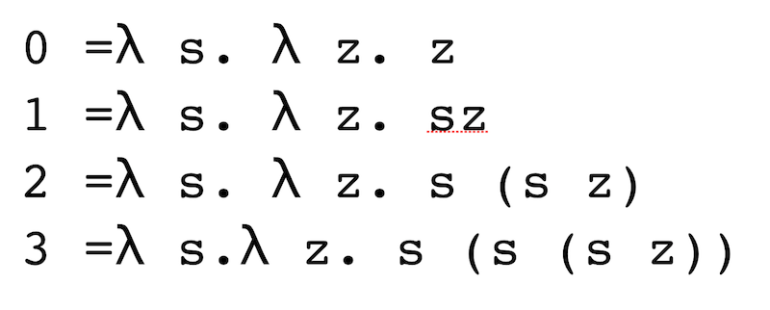
Lambda

Slide 30
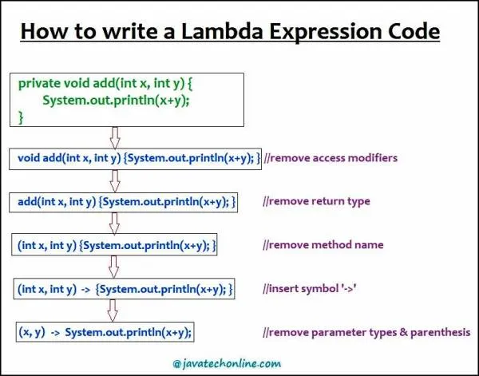
Lambda

Slide 31
Lambda
Interface iObj = (params) -> { method body };

Slide 32
Benefits of Lambda
1) We can write more readable, maintainable & concise code using Lambda expressions. 2) Also, we can incorporate functional programming capabilities in java language with Lambda Expressions. 3) We can use Lambda expressions in place of Inner classes to reduce the complexity of code accordingly. 4) Even we can pass a lambda expression as an argument to a method. 5) Additionally, we can provide lambda expression in place of an object.

Slide 33
Lambda and variables
1) We can't declare instance variable inside a Lambda expression.
2) Of course, variables declared inside Lambda expressions will be treated as a local variable.
3) ''this" keyword within Lambda expressions represents current outer class Object reference i.e. the class reference in which the Lambda expression is declared.

Slide 34
Default
Declare a method as default which has very less or negligible chances to be overridden by subclasses. This is only the best practice but should not be a thumb rule.
How can a default method save effort in writing codes?

Slide 35
Static
What is a Static method ?
What are the Static methods in Interfaces ?
- No override
Helps as general utility methods.
Higher cohesion
How to call?
By interface name

Slide 36
How will you define an Interface after introduction of default & static methods?
The interface body can contain abstract methods, default methods, and static methods.
An abstract method within an interface is followed by a semicolon, but no braces (an abstract method does not contain an implementation).
Default methods are defined with the default modifier, and static methods with the static keyword.
All abstract, default, and static methods in an interface are implicitly public, so you can omit the public modifier.
All constant declarations defined in an interface are implicitly public, static, and final. Once again, you can omit these modifiers as well.
Default & static together - wrong

Slide 37
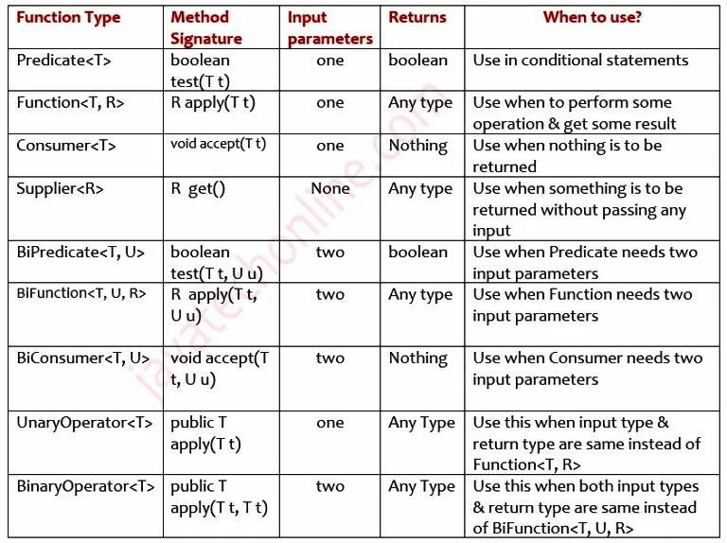
Predefined interfaces

